Slide 1

Blockaceutical
Trials Reimagined
Notes:
Jagruti

Slide 2




Conventional Tech
Current State
Current State 2.0
Conventional “Solution”
Too many systems
Too many integrations
Limited trust.
Notes:
Peter
Current State
We are starting with a slightly scary of the systems used to transport drugs to hospitals for trials from start to finish.
Currently, each manufacturer has their own ERP system they use for their inventory management and to track the products they are responsible for.
The manufacturer coordinates with couriers to transport the drugs to a storage facility. Their systems are all over the place, and some of the smaller ones rely heavily on spreadsheets or Access databases.
These are transported to storage facilities. Some of the warehouses use ERP systems, while others have more specialized warehouse management systems.
These are transported using another courier, and these are transported to hospitals. Each hospital has its own EHR system, which is used to manage all aspects of their business.
This means that a single vial of a drug could be recorded five times by five different business partners using disparate systems.
Current State 2.0
To improve on these systems, these companies are spending millions of dollars to integrate with their preferred business partners, but once Metapharma creates an integration to pass data along to courier A, it becomes more difficult for them to coordinate with courier B.
Conventional Solution
One option, that solves some of the overarching difficulties with creating better interfaces to coordinate information would be to create a single centralized database, which would need to be run by a totally separate trusted third party.
While this could cover some of the bases, it is not the best solution.
Jagruti, take it away

Slide 3





Features of Blockchain Application
Replicated Ledger
Cryptography
Integrity of ledger
Privacy
Central to all processes
Real time tracking
Accurate transactions
Accessible
Consensus
Business Logic
Decentralized Protocol
Transactions Validated
Embedded Logic
Smart Contracts
Notes:
Jagruti

Slide 4
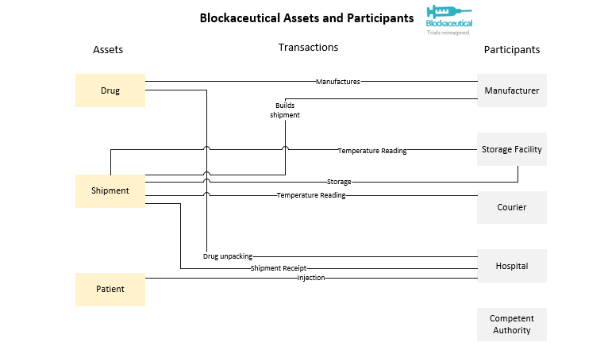
Notes:
Jagruti

Slide 5

Competent Authority
Competent authority is a “super-endorser,” approving each transaction or modification of assets.
Benefits for participation:
Safer, more accurate trials.
Better reporting from manufacturers.
Increased traceability to identify issues in supply chain.
Safer drugs going into the market that they are responsible for.
Notes:
(72 seconds)
Charles (Visualizations)
Peter (Business)
Competent authorities have a unique role in Blockaceutical.
Rather than interacting directly with assets, their only role is to participate in the consensus mechanism.
In Blockaceutical, we call this role
This helps them meet their goals by ensuring safe clinical trials, and their participation can help avoid situations where the pharmaceutical manufacturer has sketchy business deals with others, in the supply chain.
Their presence provides a huge benefit to all other participants by helping legitimize every single transaction that occurs through the supply chain.

Slide 6

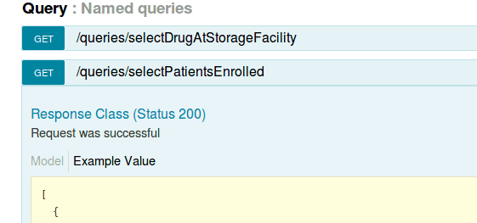
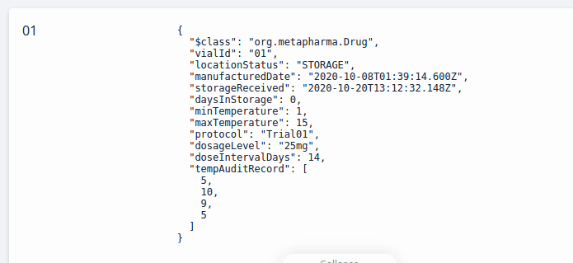
Manufacturer
Benefits for participation:
Real-time tracking
Reduces over-manufacturing wastage
Access to accurate reports
Quality assurance
.
Notes:
(72 seconds)
Charles (Visualizations)
Peter (Business)
The value proposition for businesses is traceability.
Using Blockaceutical, without additional effort, drug manufacturers can trace their drugs through the supply chain to ensure that everything is being handled on time, that there is no waste, and that hospitals aren’t delaying progress due to drug shortages.
Additionally, Blockaceutical’s consensus mechanism ensures full transparency and trust through the entire process.

Slide 7

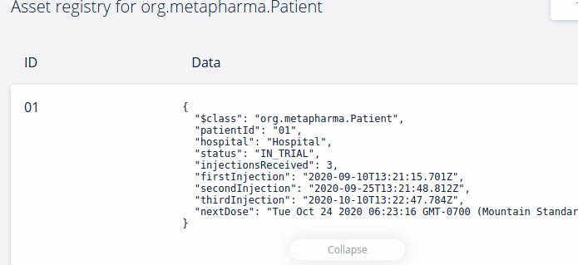
Hospital
Benefits for participation:
Access to funds
Reduced overhead costs
Automated updates to the patient's record.
Reduced costly errors in record keeping.
Traceability
Notes:
(72 seconds)
Charles (Visualizations)
Peter (Business)
Hospitals are complicated, and so are drug trials.
Blockaceutical simplifies the logistical complications and overhead associated with participating in trials and accessing those funds, including by automatically updating the manufacturer each time a drug vial is administered.
Blockaceutical provides extensive updates to everyone throughout the process, so hospitals can track their incoming drugs from the manufacturer to the hospital’s pharmacy and plan their trials accordingly.
The strict temperature protocols that Blockaceutical facilitates ensures the efficacy of drugs being administered.
Notes…
One recommendation that we received was that we should include adverse event handling. While this is important for drug trials, we determined that the manufacturers’ regulatory and legal teams would prefer to have a chance to have more control over the adverse event reporting by taking a look at the summary before submitting the narratives and having them be publicly viewable.
Access to funds associated with running trials by manufacturers in network.
Reduced overhead in coordinating and sharing information and updating stakeholders on trial progress.
Automated updates to the patient's record.
Reduced costly errors in record keeping.
Traceability of drugs through supply chain ensuring efficacy of drugs to be administered.

Slide 8
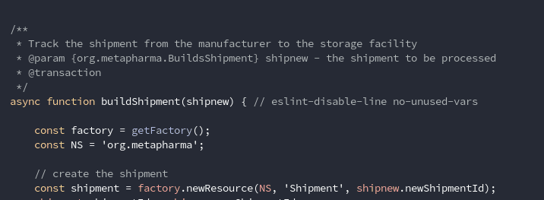

Storage Facility
Benefits for participation:
Access to storage contracts for drug trials.
Identify temperature fluctuations outside of the storage facility.
Increased ability to track incoming and outgoing shipments.
Notes:
(72 seconds)
Charles (Visualizations)
Peter (Business)
Storage facilities that are able to store drugs at precise temperatures are expensive.
Participating in Blockaceutical can help storage facilities to increase their revenue by giving them access to high-paying pharmaceutical storage contracts.
Managing these contracts is made easier through features like automated notifications when shipments start heading towards the storage facility.
Blockaceutical also reduces the risk of bad drugs arriving at the hospital, helping reduce any risk of the storage facility from taking any blame for bad drugs being delivered.

Slide 9
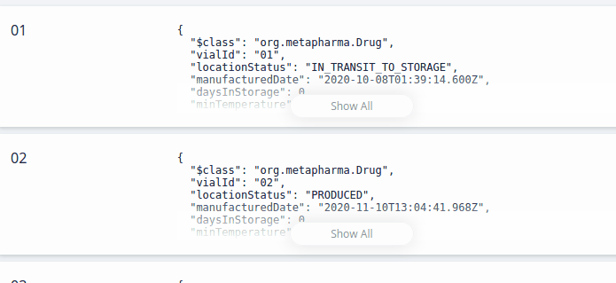

Courier Agency
Benefits for participation:
Access to high-paying contracts
Reduced Liability
Better record-keeping process
Automated updates for stakeholders
Automatic payment
Notes:
(72 seconds)
Charles (Visualizations)
Peter (Business)
For courier agencies, besides getting access to high paying contracts to deliver drugs, by using Blockaceutical, they can provide their clients with all of the updates that they need without supporting their own separate system.
Additionally, once their delivery is confirmed, they are immediately paid.

Slide 10

Business Problem
Lack of traceability
Rising costs
Inability to maintain efficiency and adequacy of data
Lengthy documentation process
Inefficient inventory process where drugs are “pulled” from the end of the supply chain
Meta Pharma
Notes:
Jagruti

Slide 11





Conclusion
Reduce Costs and Complexity
Shared Trusted Process
.
Faster Trials
Safer Delivery
Notes:
(30 seconds)
Jagruti (we are thinking of going for a private blockchain to ensure we maintain the confidentiality of the participants involved and recording accurate data from permissioned sources.)
Participation in Blockaceutical helps ensure that supply chain management is the last thing that pharma companies need to worry about during their trials.
This helps everyone make the world a better place by bringing new drugs to market faster in a more transparent way, and helps them save money by reducing waste.
Participation in Blockaceutical results in faster, safer, more successful trials at a lower cost than conventional technologies.

Slide 12

Thank You
Charles Wiegand, Peter Jachim, Jagruti Sawant
Notes:
Peter

